Slide 1

CSA1 #HEAT
https://crosseu.eu/
Aleš Urban (CZU)
Falak Naz (CZU), Katie Jenkins (UEA), Tugba Dogan (CZU) + WEMC team for the visualisation

Slide 2
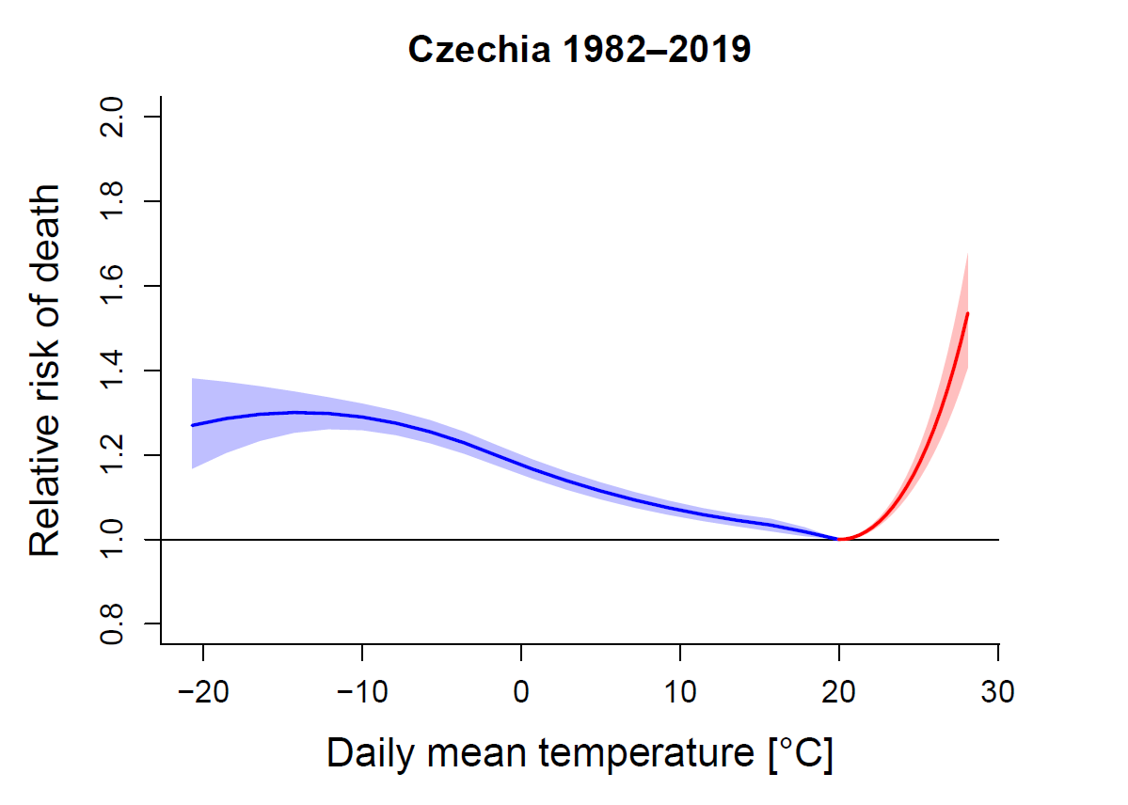

Temperature-mortality association in CZE
Cold
Heat
Adjusted for seasonal and long-term mortality changes

Slide 3
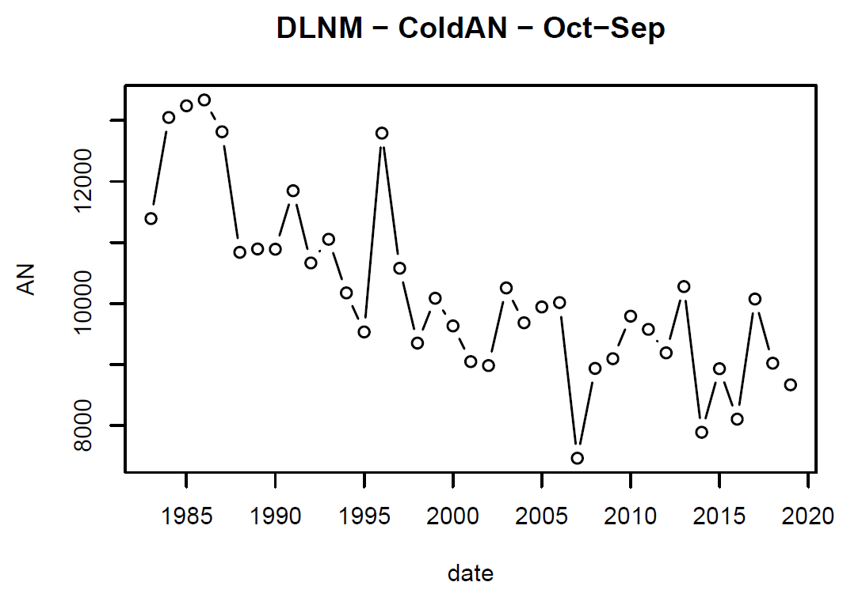
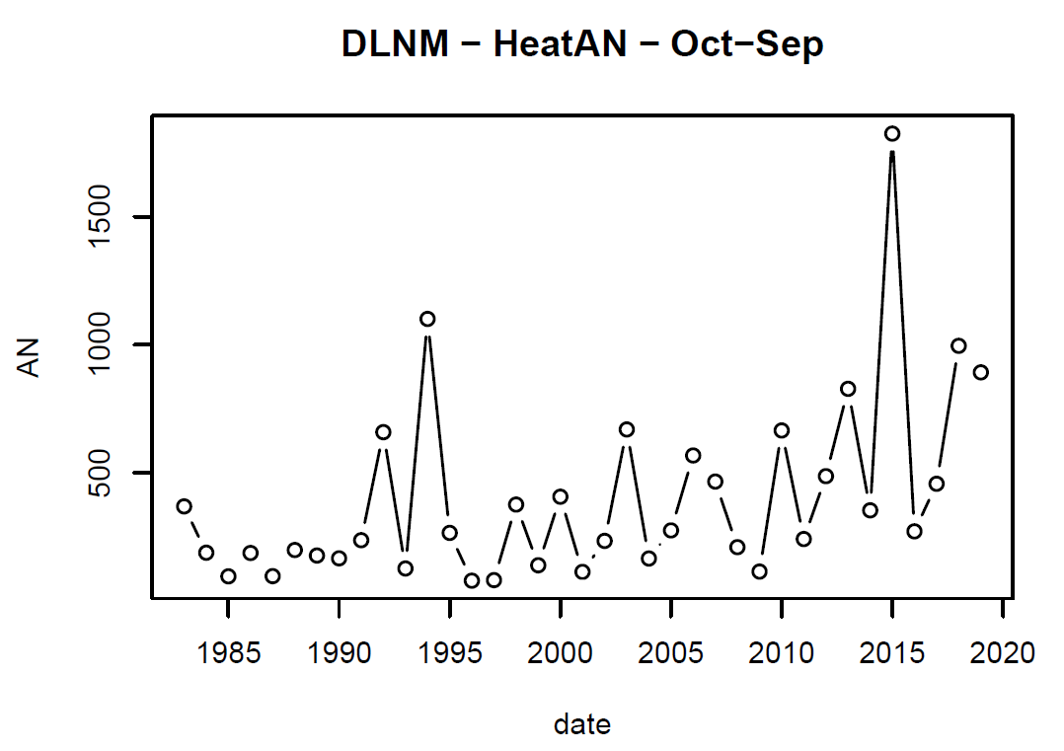
Temporal changes
Cold-related deaths
Heat-related deaths

Slide 4
Objectives
Quantify the future impacts of heat(waves) on excess mortality at the NUTS 3 level.
Assess the role of different socioeconomic and demographic scenarios (SSP storylines) in the impact estimates.
Identify most vulnerable regions in the present and future climate.
Heat-related mortality in Czechia
?

Slide 5
Data
Climate data – daily mean temperature
ERA5 reanalysis (25 km) - observations
EURO-CORDEX (12.5 km) RCP scenarios (4.5 and 8.5) – ensemble of 9 model simulations selected based on the consortium consensus (WP1)
Population data
population and mortality rate projections developed by EUROSTAT (EUROPOP2019) and the International Institute for Applied Systems Analysis (IIASA – SSP storylines)
Health data
daily mortality data 1994–2019 divided to 14 NUTS 3 regions in the Czech Republic modelling framework => DSS

Slide 6
Data
A) Deviation of annual daily mean temperature in the Czech Republic under RCP 4.5 and RCP 8.5 scenarios compared to the historical period (1994–2005)
B) The annual number of deaths in the Czech Republic, according to SSPs population projections (2020–2100)

Slide 7
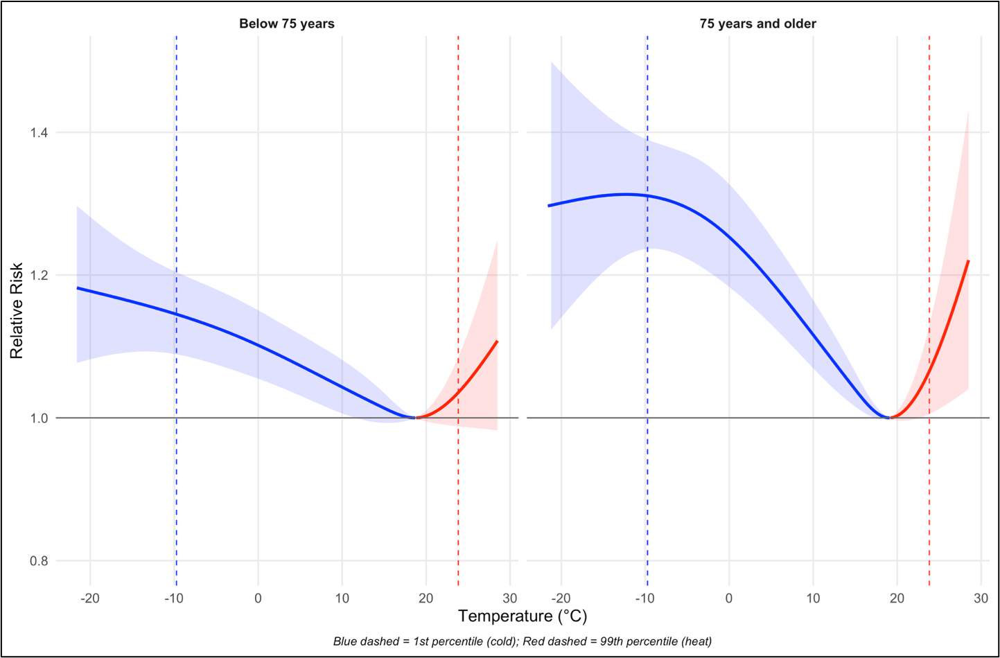
Methods – stage 1 – age-specific ERFs
Age-specific
regional
exposure-response curves
reference period (1994–2005 – historical CORDEX data)
< 75 years
75+

Slide 8
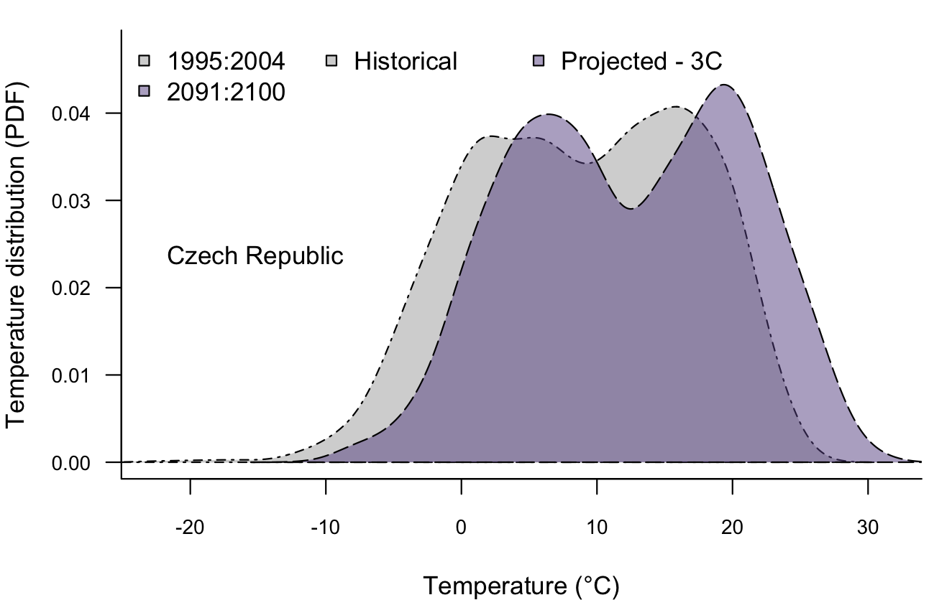
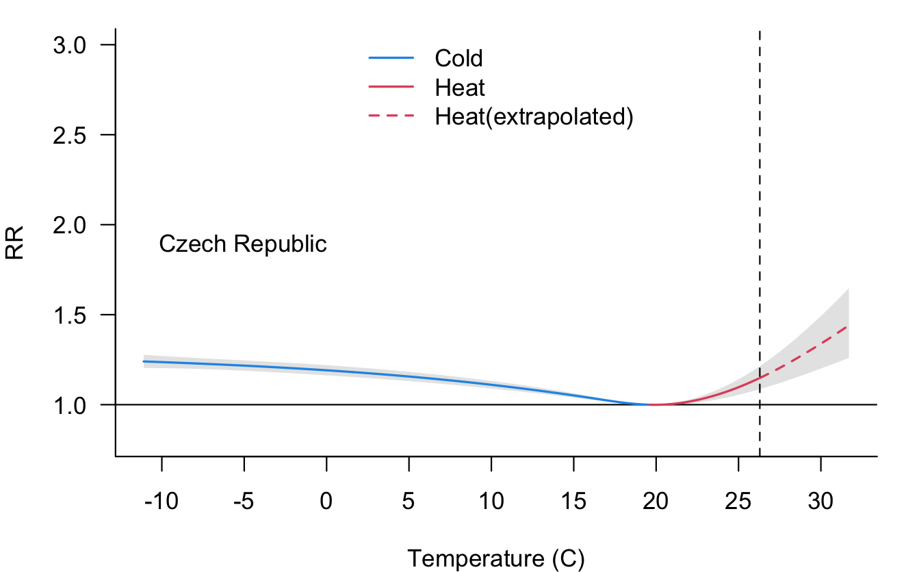
Methods – stage 2 – extrapolation to future
Age and Region-specific ERFs extrapolated to future scenarios

Slide 9
Methods – stage 3 – excess mortality
Excess (heat and cold-attributable) mortality quantification in future:
Climate change only (assuming population stays the same) => constant pop
Climate + population change (population structure changes) => changing pop
Combination of different climate (RCP4.5 and RCP8.5) and population (SSP2 and SSP5) scenarios

Slide 10
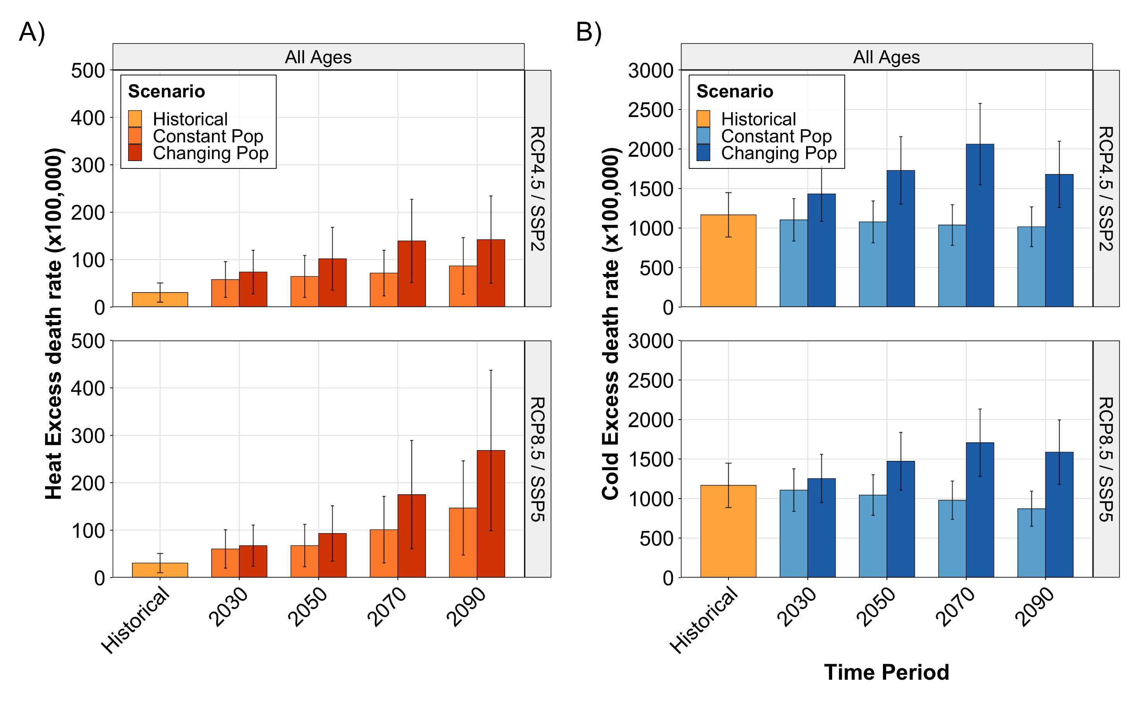
Results – excess deaths per 100,000 pop
Population ageing may substantially amplify both heat- and cold-attributable mortality in the Czech Republic.

Slide 11
Key takeaways
Population ageing may substantially amplify both heat- and cold-attributable mortality in the Czech Republic.
Ageing may erase climate-related declines in cold deaths and significantly increase heat-related mortality by the end of the century.
Public-health preparedness and adaptation planning should explicitly incorporate ageing and target older adults to reduce future mortality burdens.

Slide 12
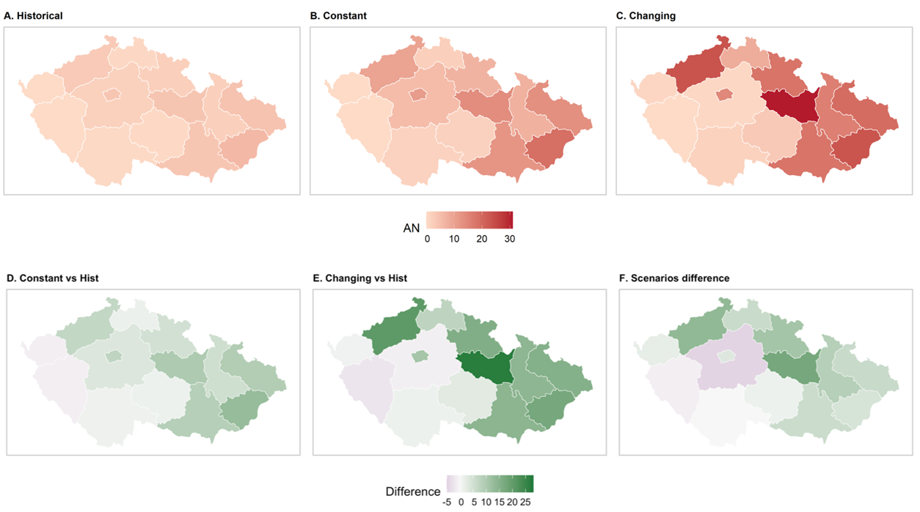
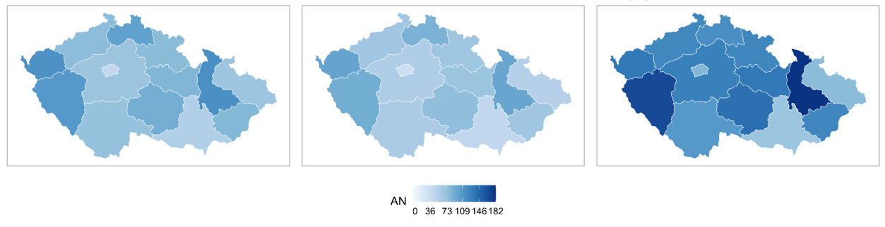
Results – spatial distribution in 2070s

Slide 13
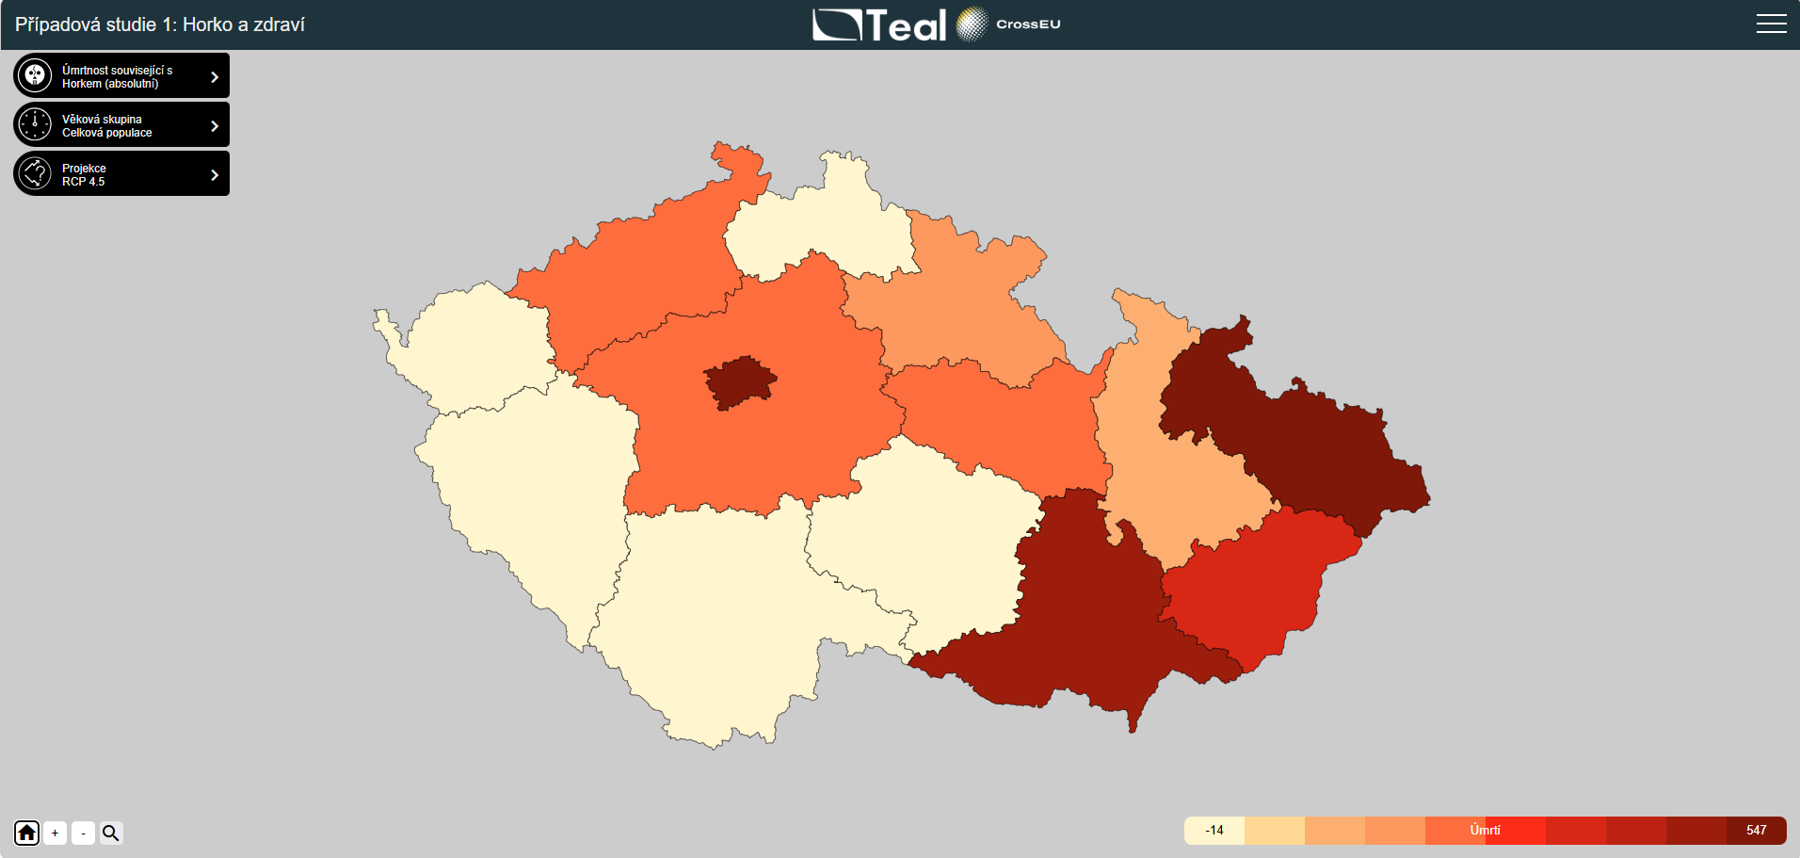
CSA1 DSS – regional results

Slide 14
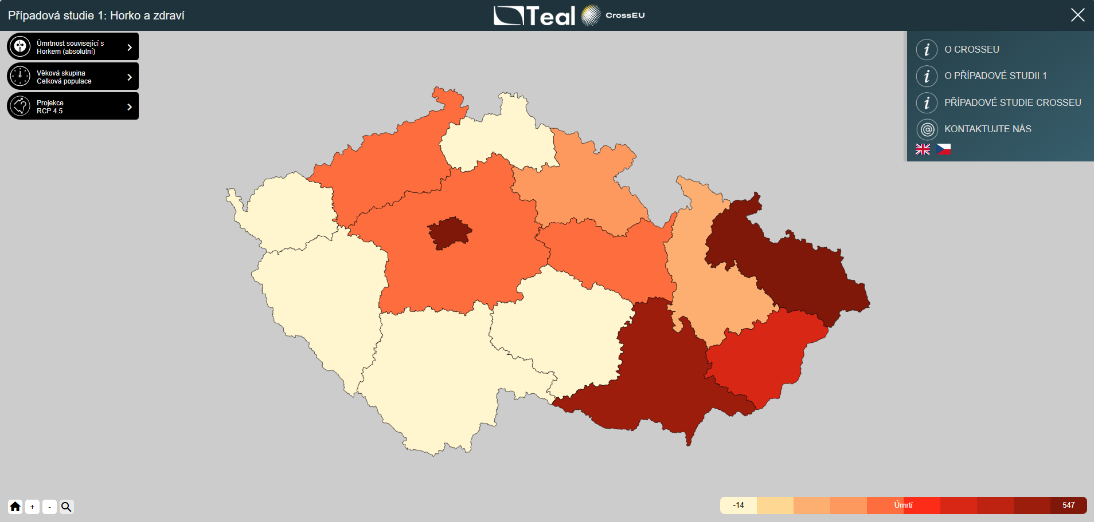
CSA1 DSS – CS menu

Slide 15
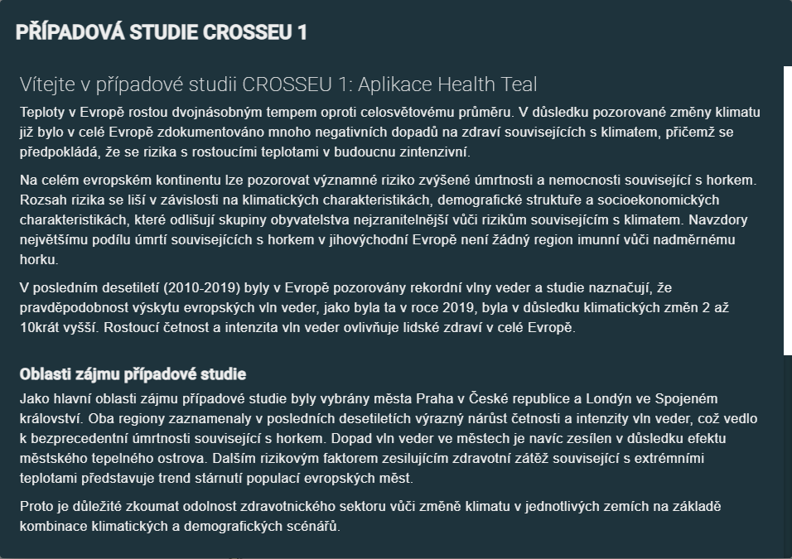
CSA1 DSS – CS context

Slide 16
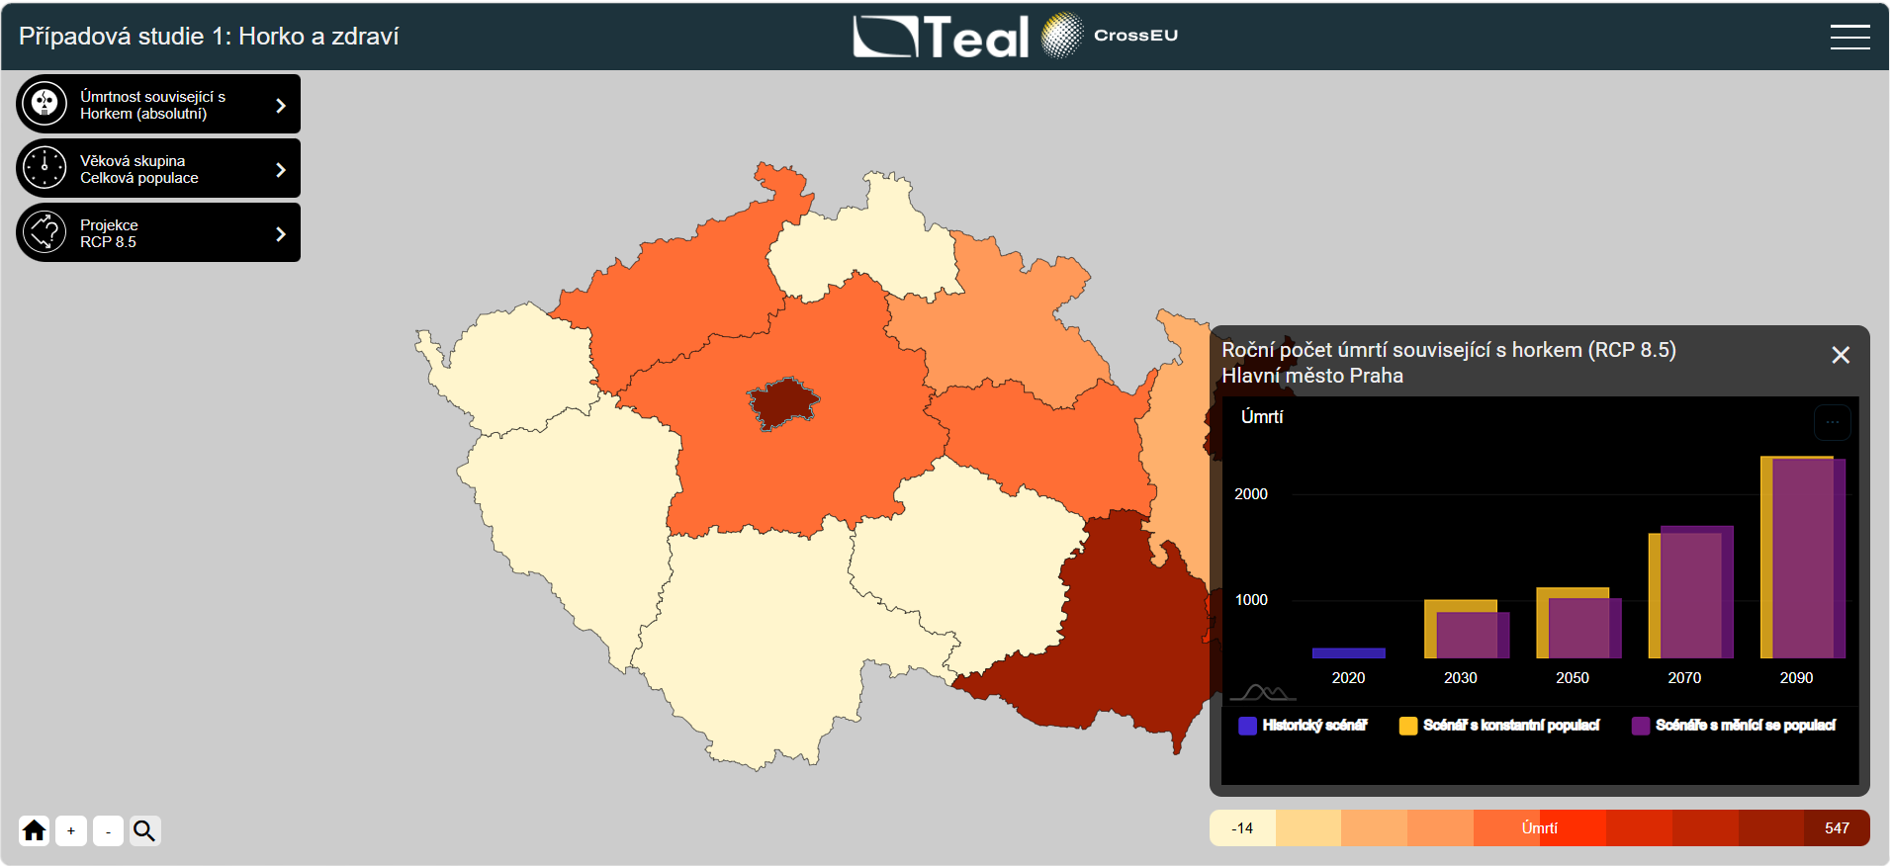
CSA1 DSS – regional projections

Slide 17
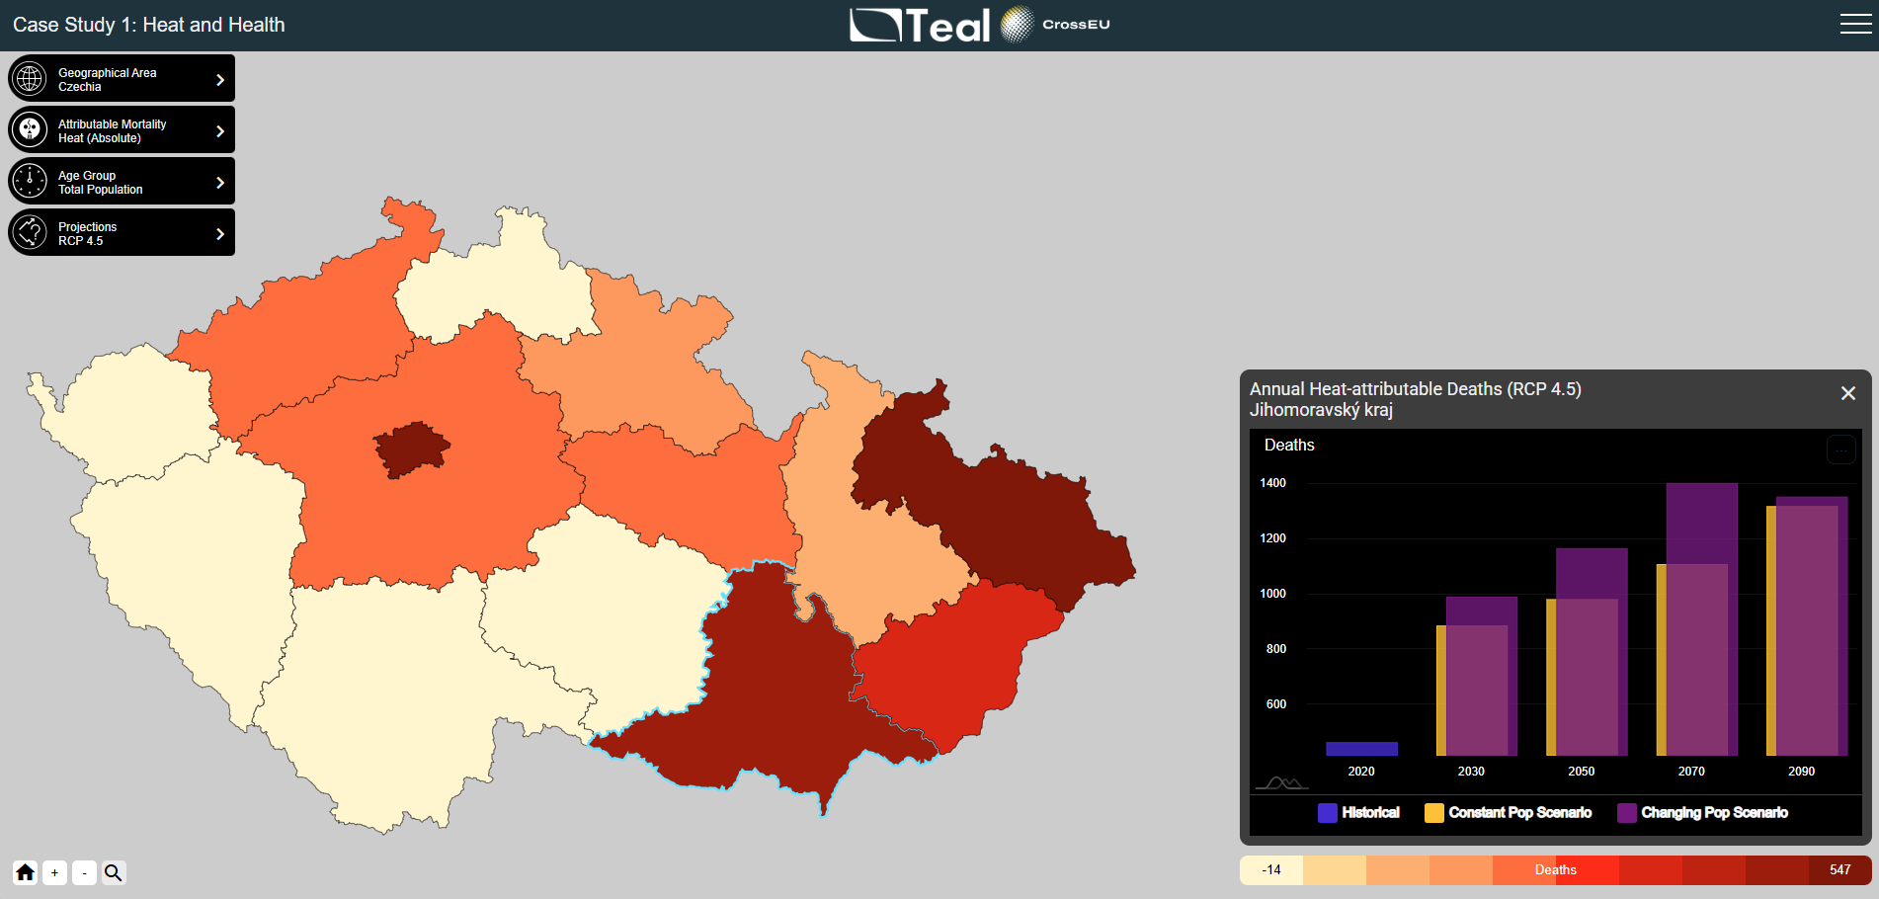
CSA1 DSS – regional projections

Slide 18
CSA1 DSS – different scenarios

Slide 19
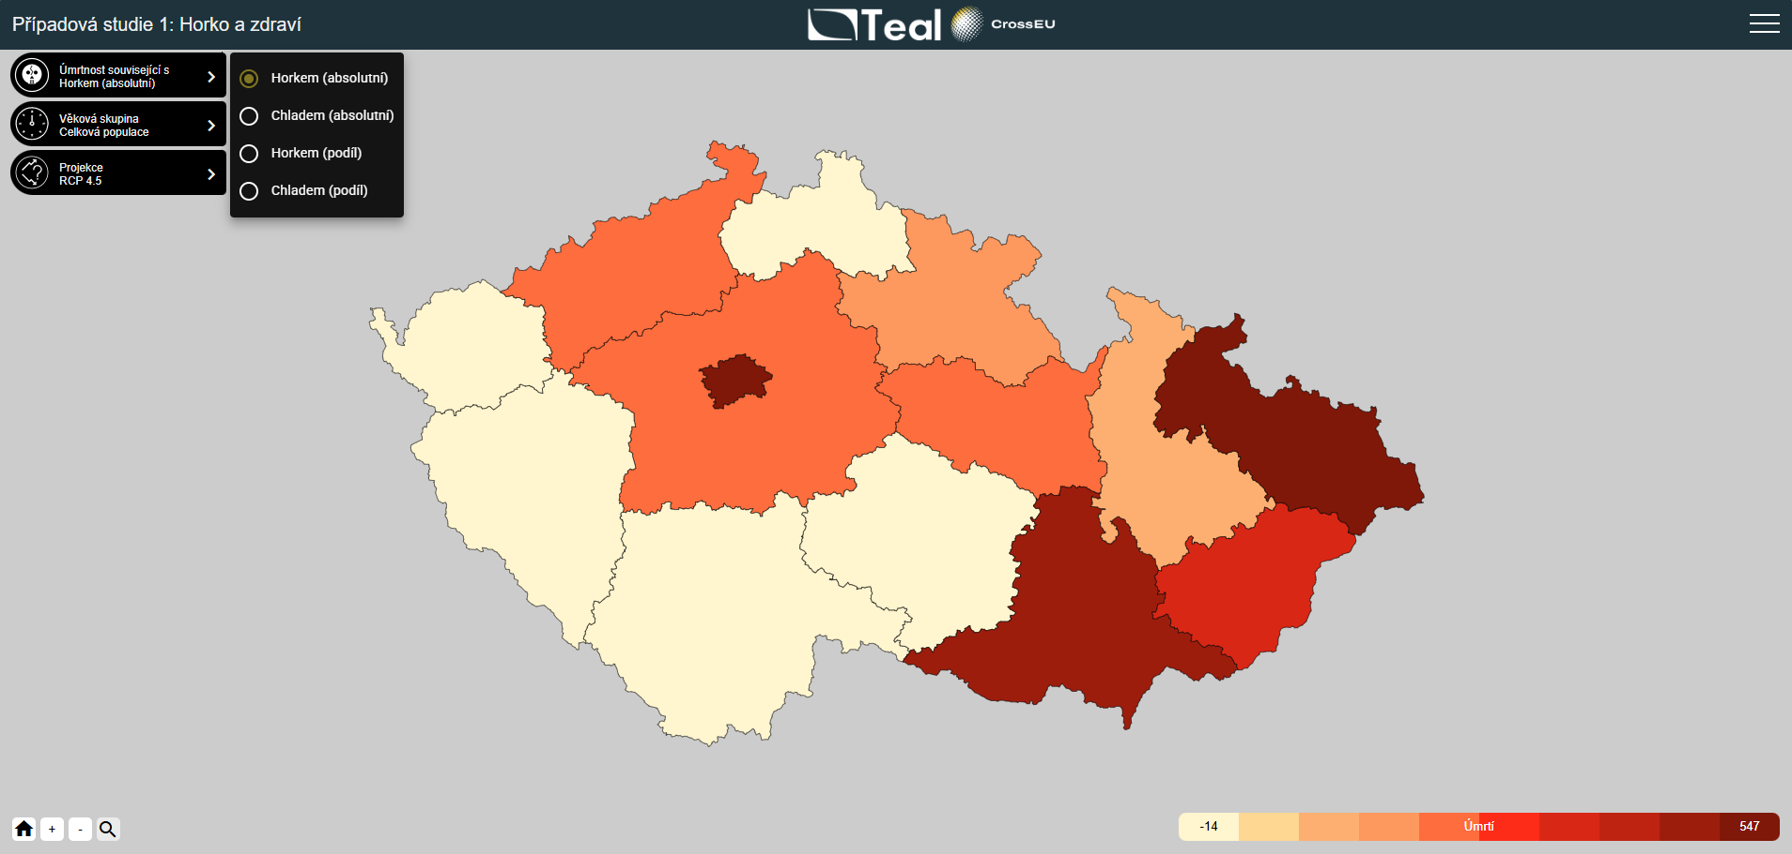
CSA1 DSS – heat vs cold

Slide 20
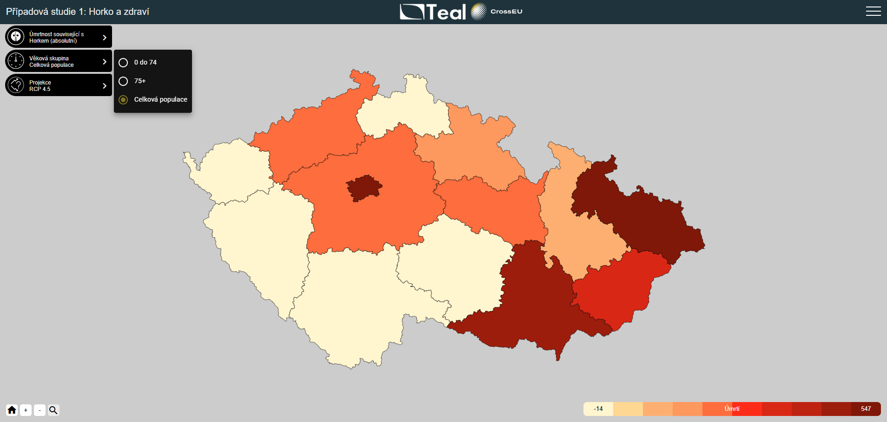
CSA1 DSS – age groups

Slide 21
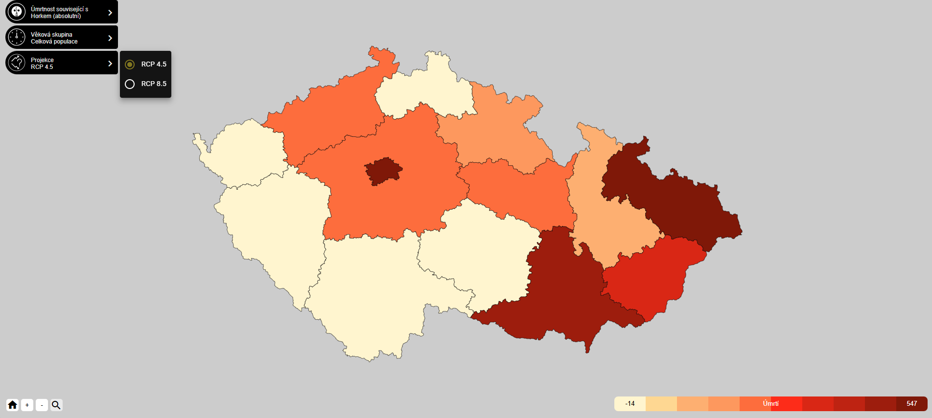
CSA1 DSS – RCP and SSP scenarios

Slide 22
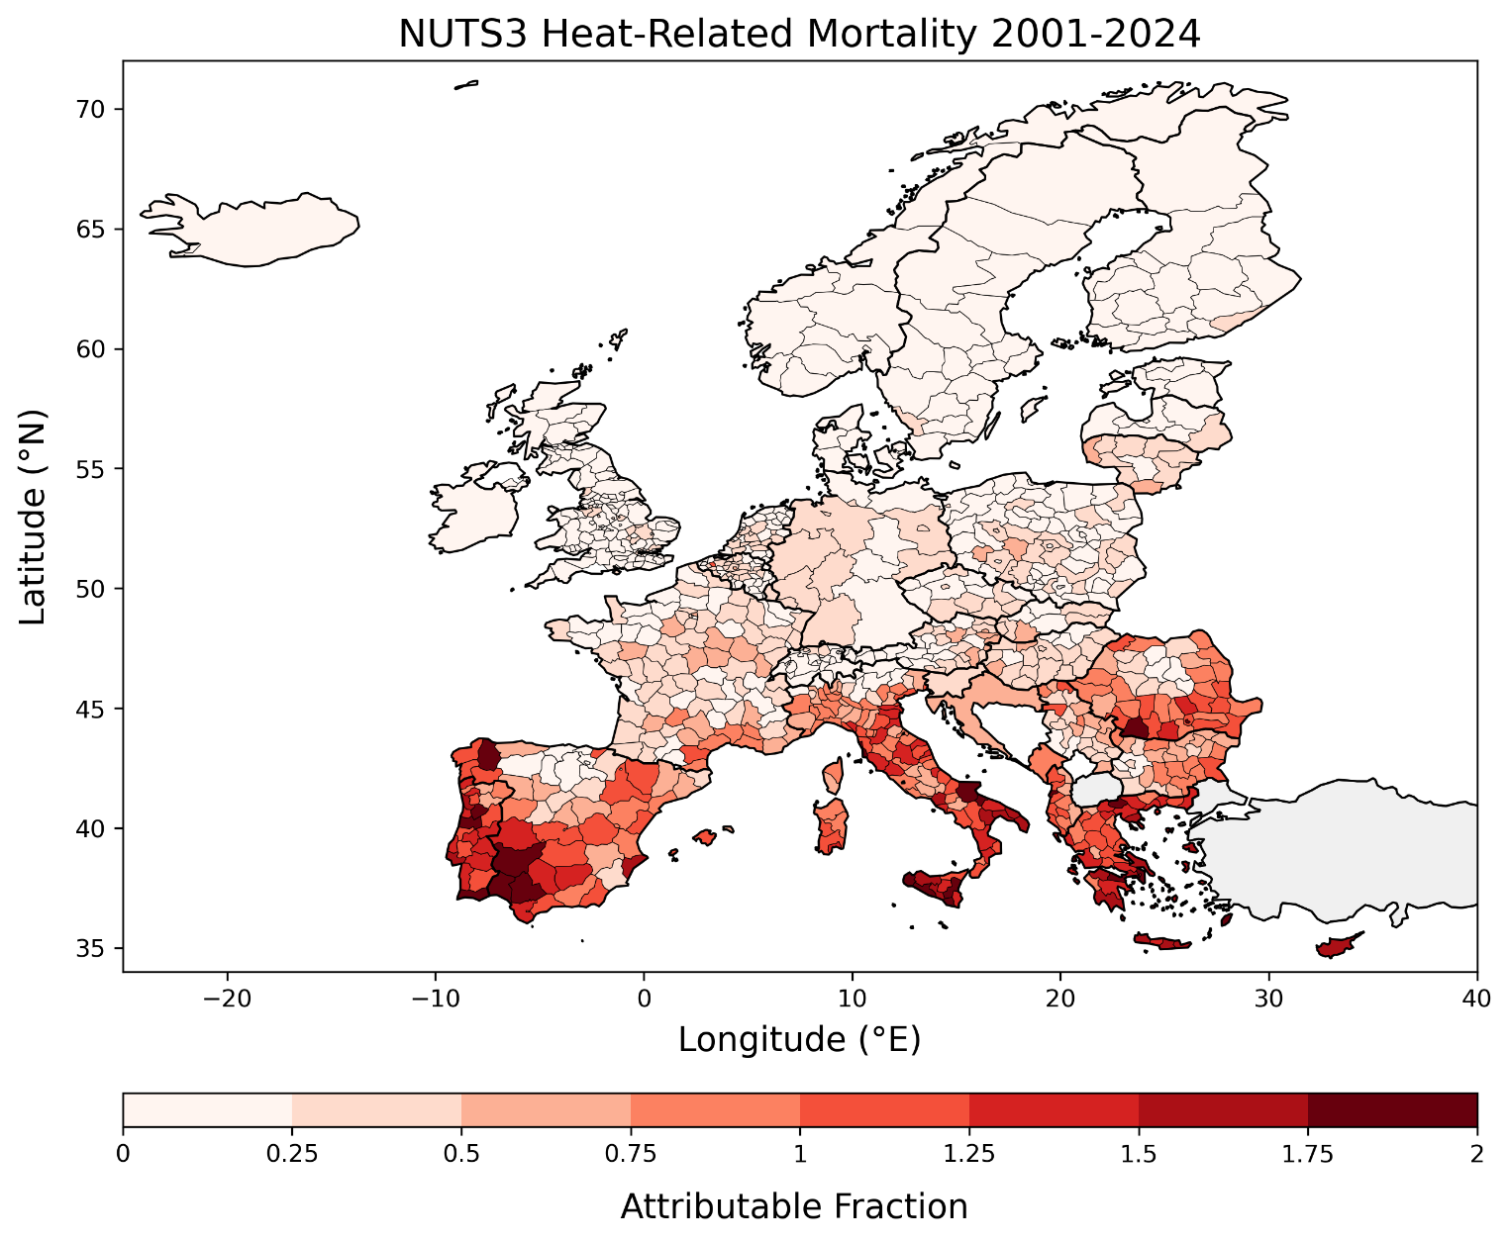
Upscale to the whole EU
weekly mortality data at the EU NUTS 3 level 2001–2024
credit: Saumya Singh (CZU)

Slide 23

Additional information needed
Decision support system – what information is useful?
What questions should be answered by the DSS?
https://www.mentimeter.com/app/presentation/alw4ew733i5ug4iu38um2jmvzqsemfkd/edit?question=xa7cnt9mzsyo
https://www.menti.com/
Code
7185 2291

Slide 24
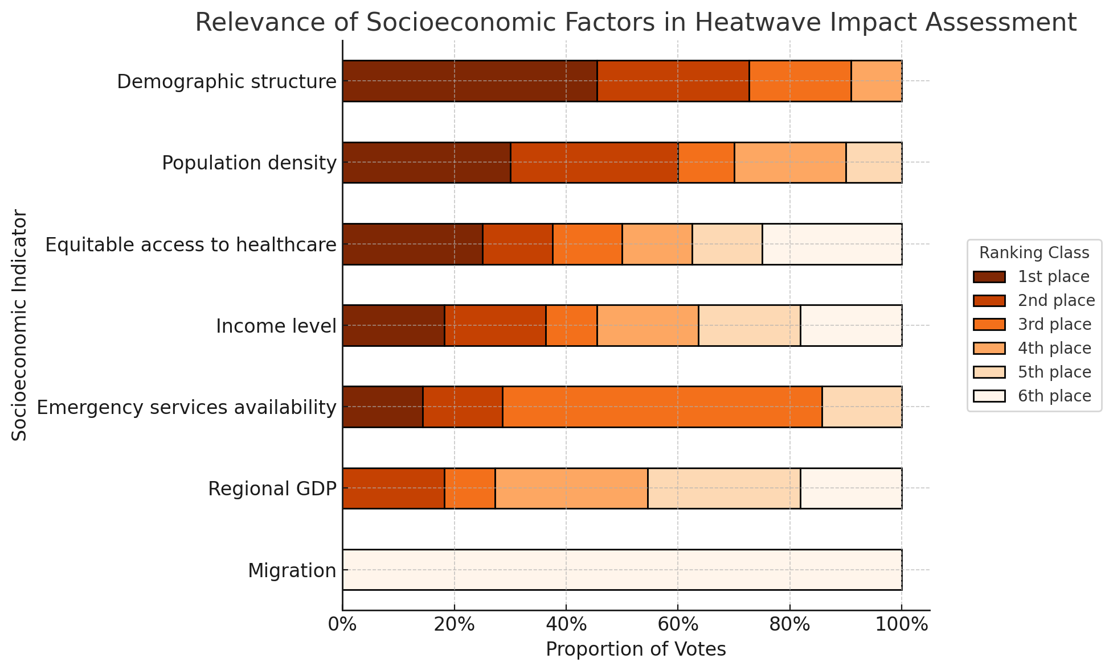
Useful information for stakeholders?

Slide 25
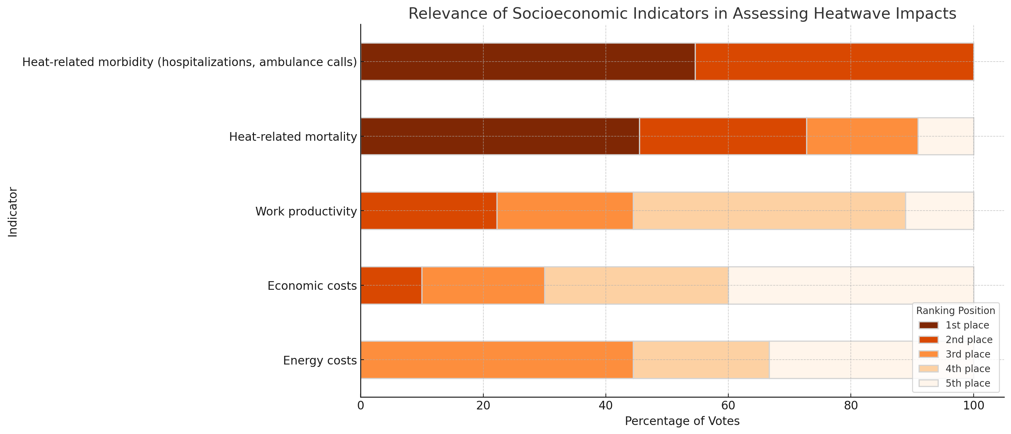
Useful information for stakeholders?

